Slide 1
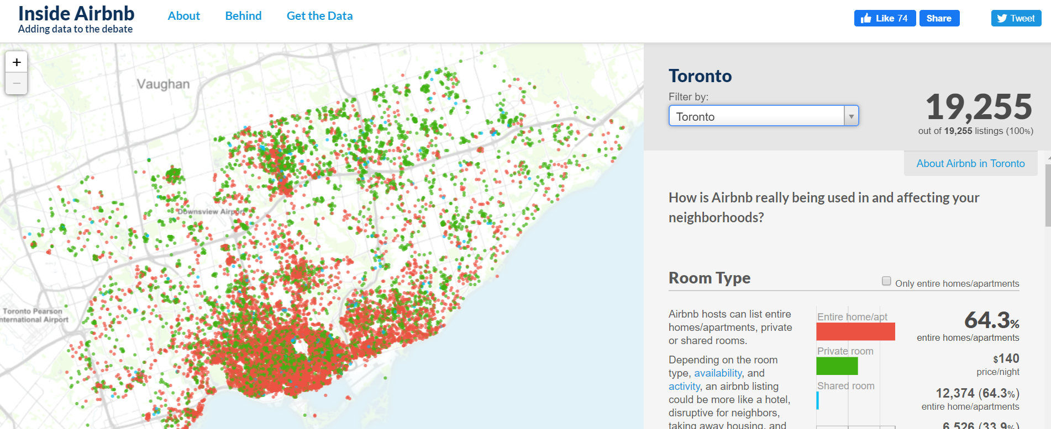
Toronto Airbnb: Exploratory data analysis and Application of classification algorithms
Reaz Elias
December 9, 2019

Slide 2
Abstract
Airbnb (Airbed and breakfast) is an online marketplace for arranging and offering lodging, specifically homestays. Airbnb acts as an online broker receiving commissions from each booking (source: Wikipedia).
In this project, Toronto Airbnb dataset is analyzed to investigate rent or price variation by neighbourhood, room types, room counts, number of reviews, and availability. Details of exploratory data analysis (EDA) is utilized to detect relationship among price, neighbourhood, room types, and availability.
Machine learning classification models based on logistic regression and random forest are applied to find room types (e.g., “entire room/apt”, “private room”, “shared room”, or “hotel room”) based on input features of neighbourhood, number of reviews, prices, and availability.

Slide 3
Motivation
In the city of Toronto, Canada, during past few years, house rents have sky-rocketed to incredible levels. According to a report, rent costs in Toronto are increasing twice as fast as incomes (https://torontostoreys.com/2019/10/home-prices/).
This project takes an opportunity to delve into Toronto Airbnb dataset to analyze rent prices by several factors, such as neighbourhood and room types.
There are two segments in the presentation. One is exploratory data analysis that covers data cleaning, data visualization via several boxplots, barplots, and sactterplots, and drawing conclusions from these plots. The second one is application of machine learning classification algorithms, namely, logistic regression and random forest.

Slide 4
Dataset(s)
Toronto Airbnb dataset is analyzed. The dataset is accessible at: http://insideairbnb.com/toronto/
“listings.csv” file is used: df = pd.read_csv("listings.csv")
The dataset has 21,900 rows and 16 columns.
The column names are: id, name, host_id, host_name, neighbourhood_group, neighbourhood, latitude, longitude, room_type, price, minimum_nights, number_of_reviews, last_review, reviews_per_month, calculated_host_listings_count, availability_365.

Slide 5
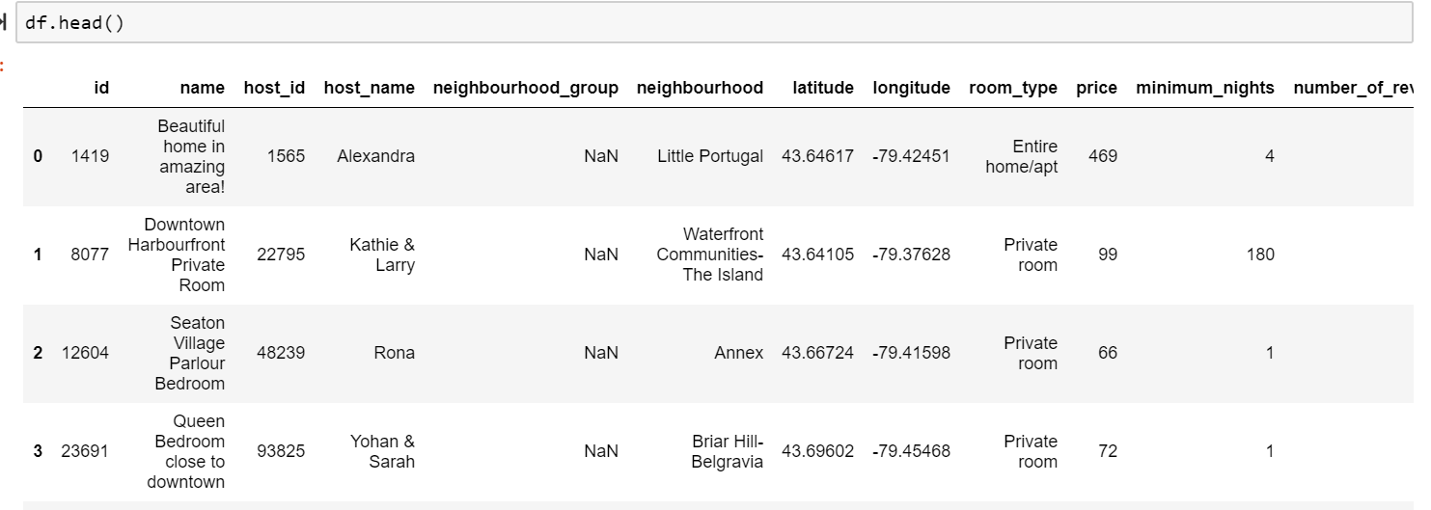
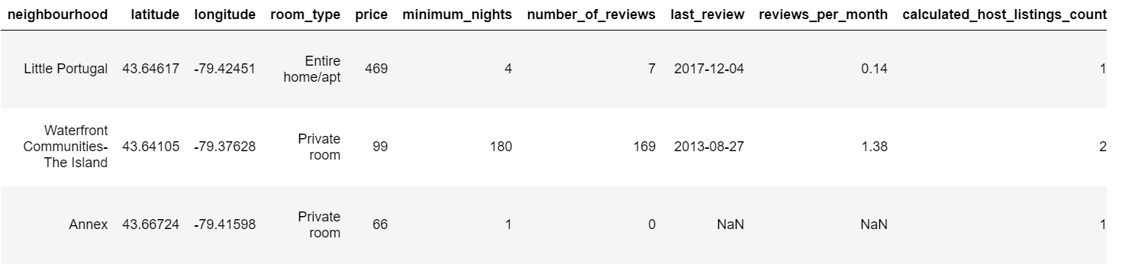
Snapshot of the dataframe

Slide 6
Data Preparation and Cleaning
Data preparation and cleaning are major parts of any data science project.
There could be inconsistent feature names, missing and/or duplicate values, redundant columns/features, inconsistent datatypes (e.g., dates are as strings), and abnormal values or outliers.
We need to do visual inspection, graphical visualization by plotting, for example, box plot and pairplot to detect and solve these inconsistencies.

Slide 7
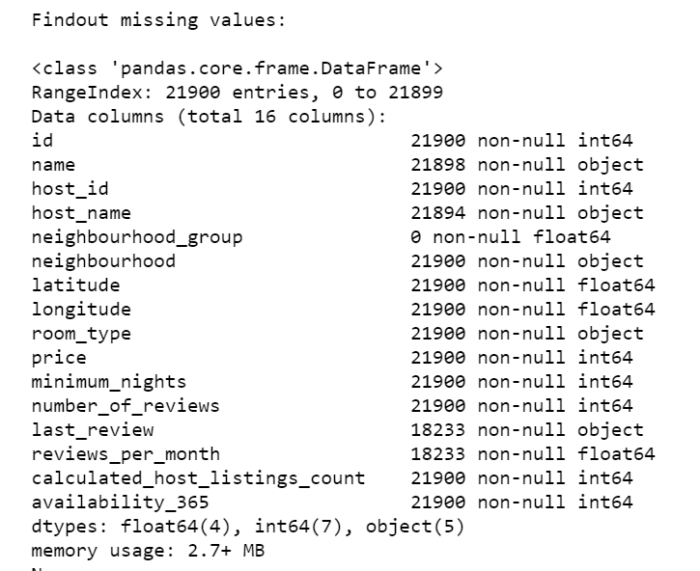
Looking for missing values
“neighbourhood_group” column is full of NaN values. Hence the column is dropped.
“number_of_reviews” that contains 0 values has also “NaN’ values in ‘reviews_per_month’. Therefore, “reviews_per_month” is considered redundant and dropped.
Similarly, columns that are not required for the analysis are dropped, e.g., id, name, host_id, host_name, neighbourhood_group, last_review, reviews_per_month, calculated_host_listings_count.

Slide 8
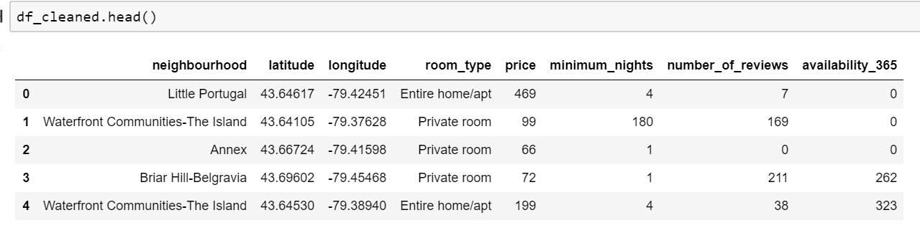
Dataframe after dropping irrelevant columns

Slide 9
Research Question(s)
What are the mean price and its standard deviation for the Toronto Airbnb?
How does the price vary by room types and neighbourhood? Which neighbourhoods are expensive? Which room types are more available – “entire room/apt”, “private room”, “shared room” or “hotel room”?
Is there any relationship between price and number of reviews given by the users? Or between price and availability (in days per year)?
Can we predict room type given input features of neighbourhood, latitude, longitude, prices, number of reviews, and availability? How do results from logistic regression differ from random forest classifier?

Slide 10
Methods
pandas, an open-source data analysis software package in python, is utilized for exploratory data analysis.
Several boxplots, violinplot, barplots, and scatterplots are presented to find answers on relationship among price, neighbourhood, room types, number of reviews, and availability.
Two machine learning classification algorithms, logistic regression and random forest are applied to detect “room type” based on input features of neighbourhood, latitude, longitude, price, minimum nights, number of reviews, and availability.
scikit-learn modules for label coding, data scaling, train-test splitting, 5-fold cross validating with grid and randomized searches are utilized.
All codes are reproducible and available at the following link: https://github.com/EliasReaz/UC_SanDiego_project/tree/master/Toronto_Airbnb

Slide 11
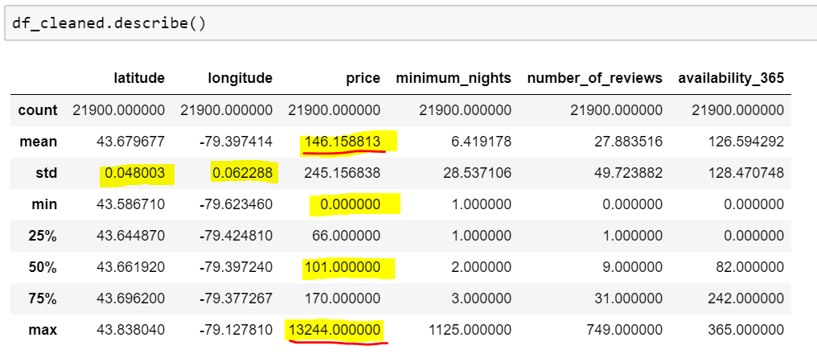
Finding: mean, std. dev., median, min. and max. prices
Mean Airbnb price is CAD 146, the standard deviation is CAD 245, which is almost 1.7 times of the mean price.
75% of the prices are below CAD 170. This indicates the presence of extreme prices like CAD 13,244.
The boxplot in the next slide also reveals this fact.

Slide 12
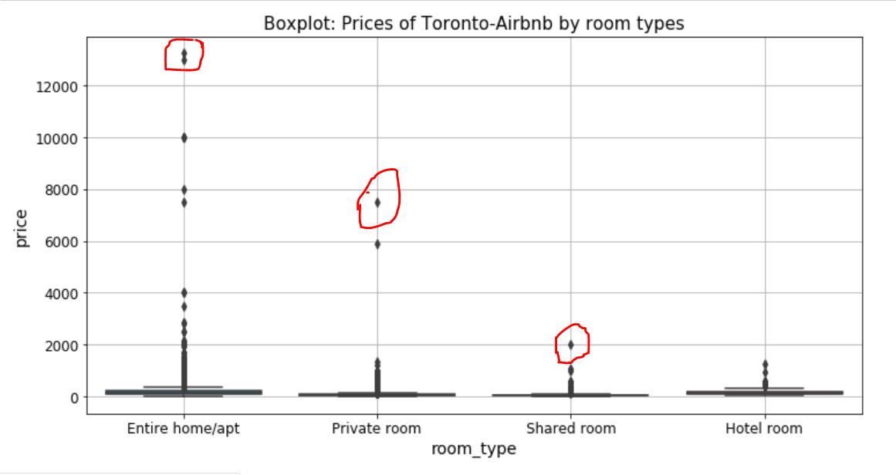
Finding: Boxplot showing extreme prices as outliers

Slide 13
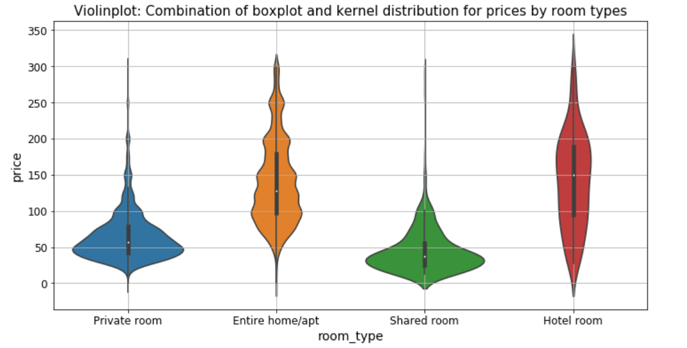
Finding: Violin plot showing both boxplot and distributions of prices
A violin plot after dropping outliers.
The plot shows that there exists price variations by room types.
Private and shared rooms have mean prices around CAD 50, while hotel rooms have mean price approximately CAD 150. Entire room/apt has a mean of CAD 125.

Slide 14
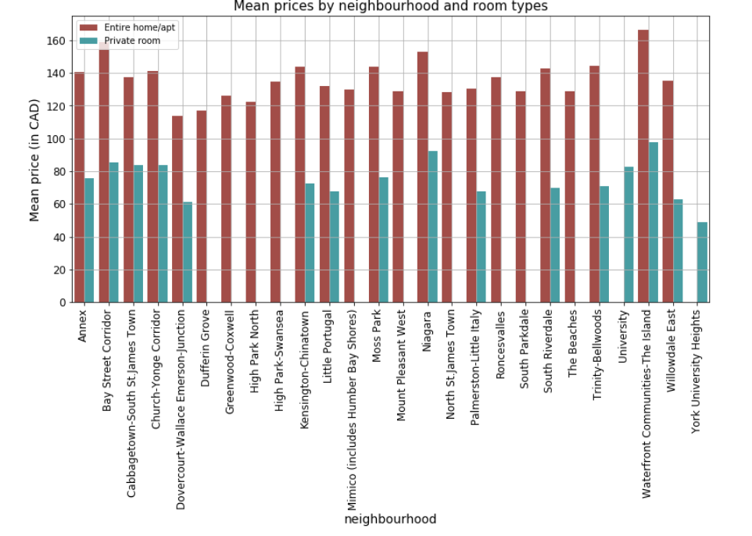
Finding: Mean price variation by neighbourhood and room types
Waterfront, Bay Street, and Niagara are, on average, expensive areas in Toronto.
In Greenwood-Coxwell and High Park areas, all rooms (with mean prices above CAD 100) are rented as entire room/apt.

Slide 15
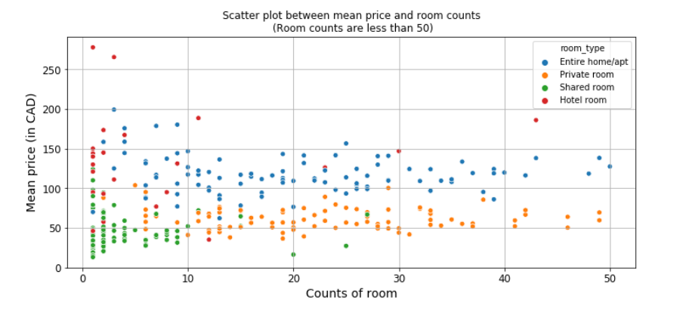
Finding: Relationship between price and room counts
The scatter plot shows that room type “Entire room/apt” has higher prices than “Private room”

Slide 16
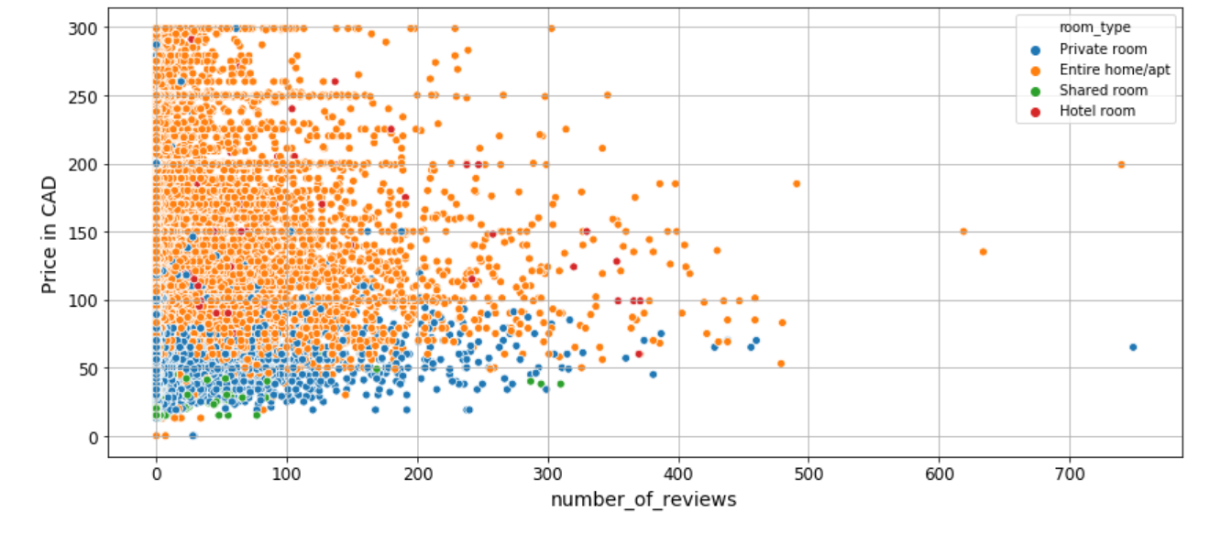
Finding: Relationship between price and number of reviews by room types
The scatter plot shows little relationship between number of reviews and overall prices, but there exists a class division between room type “Entire room/apt” and “Private room”.

Slide 17
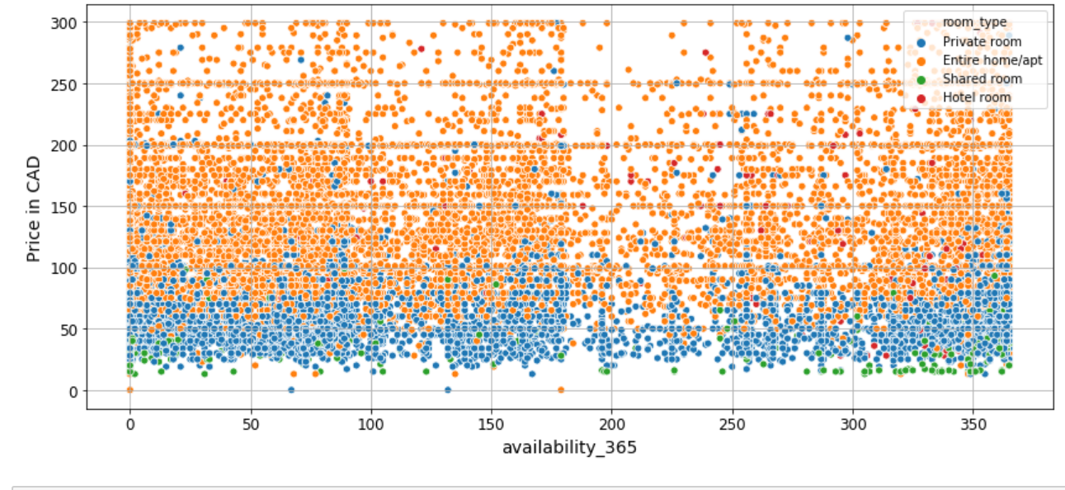
Finding: Relationship between price and availability
The scatter plot here also shows no relationship between availability and prices.

Slide 18
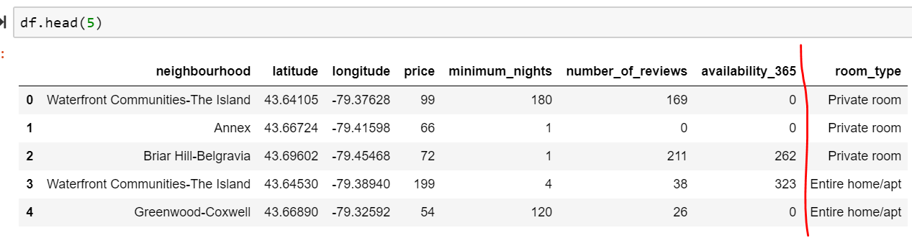
Applying classification models
Objective is to classify “room type”. The room types: Entire room/apt, Private room, Shared room, and Hotel room.
Input features: neighbourhood, latitude, longitude, price, minimum_nights, number_of_reviews, availability_365.
Response label: room_type.

Slide 19
Label encoding and scaling
Categorical features, such as neighbourhood and room type are encoded by using scikit-learn’s preprocessing.LabelEncoder( ).
For example, room type “Entire room/apt” is encode to 0, “Hotel room” to 1, “Private room” to 2, and “Shared room” to 3.
Numerical features, for example, latitude, longitude, price, minimum_nights, number_of_reviews, and availably_365 are scaled by using scikit-learn’s preprocessing.MinMaxScaler( ).
MinMaxScaler( ) subtracts minimum value from each instance and then divide by the range of the specific feature values.
MinMaxScaler( ) retains the shape of the original distribution.
MinMaxScaler( ) has a default range of 0 to 1.

Slide 20
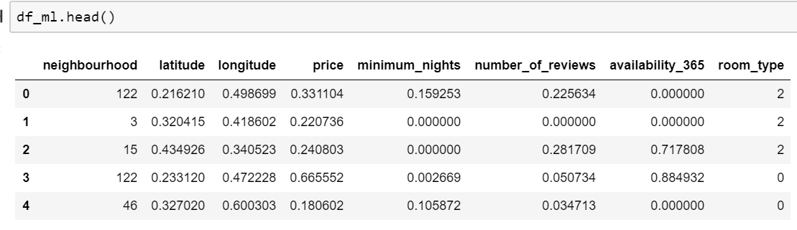
Label encoding and scaling
After applying label encoding and min-max scaling, the dataframe looks as below:

Slide 21
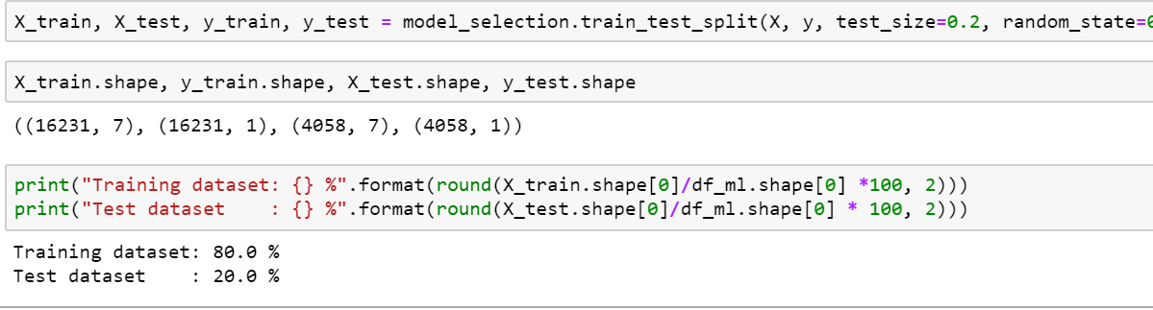
Split the dataset: Train and test sets
test_size = 0.20
80% of the dataset is used as a training set and 20% are used as a test set.
During training, five-fold cross validation is applied to tune hyper-pameters.

Slide 22
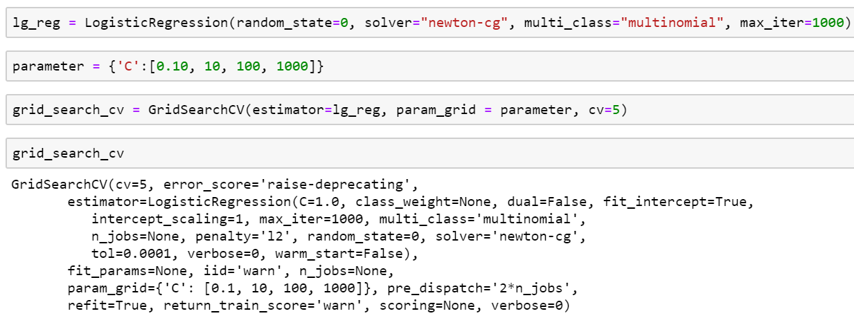
Logistic regression
Scikit-learn’s linear_model.LogisticRegression( ) and model_selection.GridSearchCV( ) has been utilized:

Slide 23
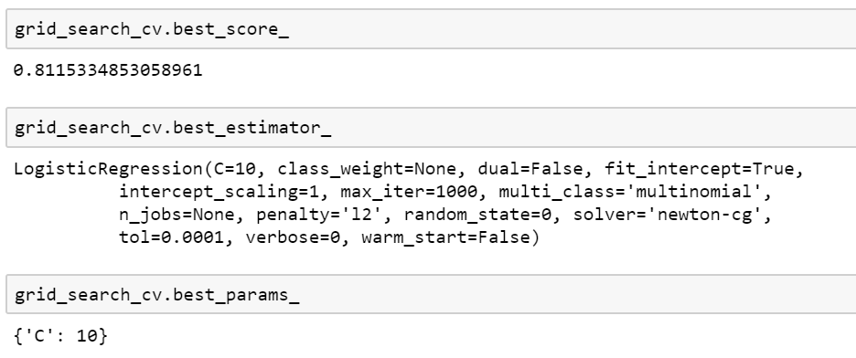
Logistic regression with grid search cross-validation
Grid search finds the best value of “C” as 10.
“C” is the strength of regularization parameter in the logistic regression.
C is the inverse of λ. A high value of C refers to a lower value of λ.

Slide 24
Applying random forest classifier
Random forest is an ensemble model that incorporates collection of de-correlated decision trees. Following hyperparameters are tuned using randomized search cross-validation:
n_estimator: number of trees in the forest
max_features: maximum number of features considered for splitting a node
max_depth: maximum number of levels in each decision trees
min_sample_leafs: min. number of data point allowed in a leaf node
min_sample_spilts: min. number of data points placed in a leaf before before the node is split
bootstrap: method of sampling data point (with or without replacement)

Slide 25
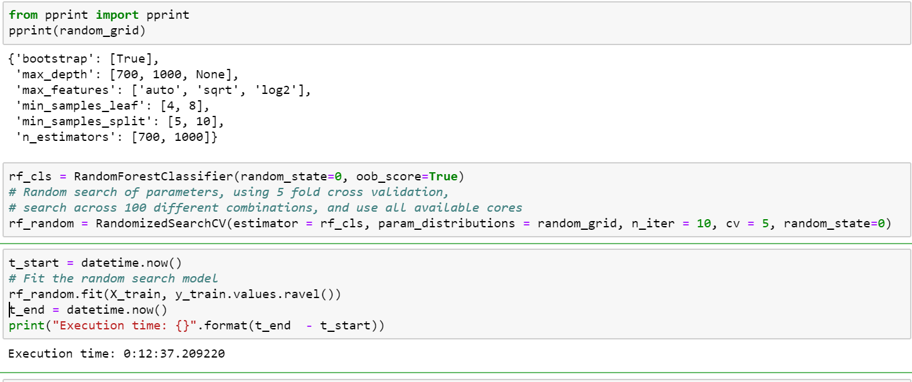
Applying random forest
Following is an excerpt from the applying random forest classifier with five-fold cross-validation along with randomized search:

Slide 26
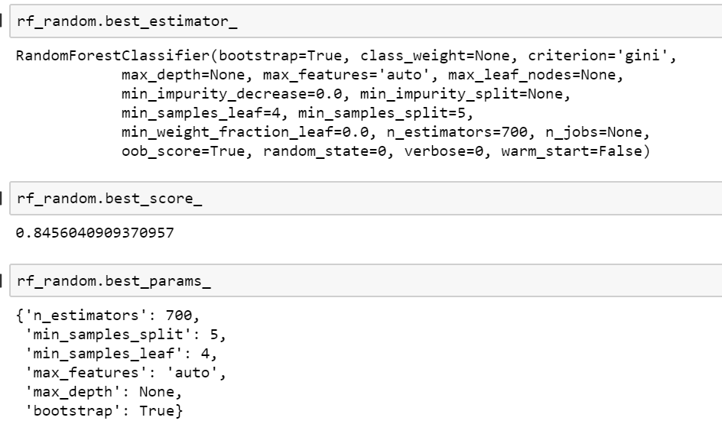
Random forest: best_estimator_
Best estimators

Slide 27
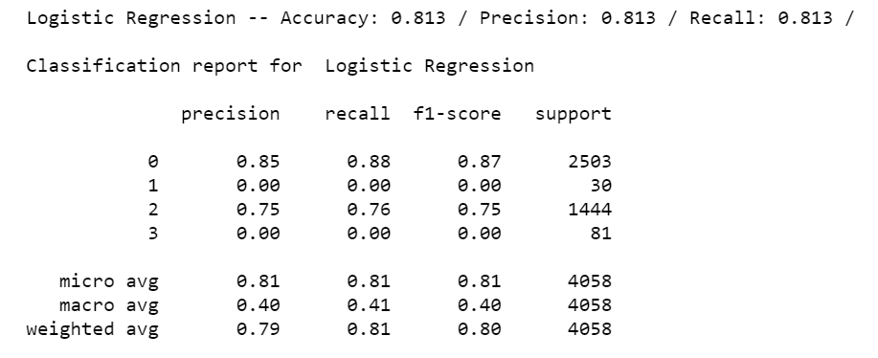
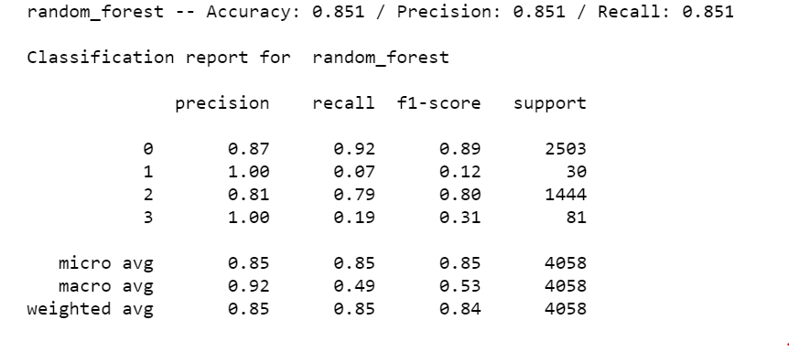
Comparison of models
While accuracy of logistic regression is 81%, random forest provides an accuracy of 85%.
Accuracy is the ratio of the number of correct predictions to the total number of samples.
A reminder is that class 0 refers to “Entire room/apt”, 1 indicates “Hotel room”, 2 denotes “Private room” and 3 refers to “Shared room”.
Classification reports for both models show that random forest outperforms logistic regression in terms of precision and recall also.

Slide 28
Conclusions
Toronto Airbnb dataset is analyzed. The project has two parts:
Exploratory data analysis that includes data cleaning, data visualization, and exploration to find pattern or relationship between price and neighbourhood, price and room types, price and number of reviews, and price and availability.
Application of classification models, such as logistic regression and random forest.
The analysis shows that waterfront, bay street, and Niagara are one of the expensive areas for Toronto Airbnb.
Mean price for “entire room/apt” is approximately CAD125, “private” and “shared” rooms are close to CAD50 and “hotel room” is about CAD150.

Slide 29
Conclusions
Scatter plots between price and number of reviews and between price and availability show that there are little relationships among them.
Applications of logistic regression and random forest are used to classify room types based on neighbourhood, latitude, longitude, price, minimum_nights, number of reviews, and availability.
Categorical features like neighbourhood and room types are label encoded.
Numerical features, such as latitude, longitude, and price are scaled to 0 to 1 by a min-max scaler.
Dataset is split as training set (80%) and test set (20%).

Slide 30
Conclusions
It is observed that random forest outperforms logistic regression in performance, precision, and recall scores.
Reasons that random forest performs better than logistic regression are:
Random forest is one of the most well-known ensemble models.
It combines large number of independent decision trees.
It is trained over random and equally distributed subsets of a dataset.
It offers less overfitting.
Logistic regression is a linear model and hence works better where there exists a linear relationship.

Slide 31
Limitations
A Toronto city-map showing colorful representation of price variations along the latitude and longitude would be a great presentation.
An interesting analysis would be how user/tenant ratings affect the Airbnb price. Unfortunately, the dataset does not contain user ratings.
The correlation matrix is not claculated.

Slide 32
References
Wes McKinney (2017) Python for Data Analysis, 2nd edition, O’Reilly, Sebastopol, CA, USA.
Lecture notes from UCSanDiego EdX.
Various resources from the stackoverflow.

